Slide 1
NHS 2025-2026
MILTON NHS
08/26 NEW MEMBERS MEETING
CONGRATULATIONS AND WELCOME!!

Slide 2

NHS STANDARDS
-SCHOLARSHIP
-SERVICE
-LEADERSHIP
-CHARACTER

Slide 3
25-26 LEADERSHIP
President: Mili Desai
VP of Service: Hollis Thompson
VP of Membership: Imani Reid
VP of Communications: Ashna Kutty
mili.desai.p@gmail.com
hollisdt@icloud.com
imanireid97@gmail.com
ashnakutty2019@gmail.com

Slide 4
CONTACTS
Mili - mili.desai.p@gmail.com
General questions, opportunities, hour requirements
Hollis - hollisdt@icloud.com
MobileServe/point logging, opportunity attendance
Imani - imanireid97@gmail.com
Hour requirements, member info, probation status
Ashna - ashnakutty2019@gmail.com
Remind & any communication questions
General email:
miltonnhs01@gmail.com
Sponsors:
Ms. Denney (denneyr@fultonschools.org) & Mrs. Silverman (silverman@fultonschools.org)
●Dismissal, payment, or membership requirements

Slide 5
INSTALL REMIND!!!
Senior Code:
@72842hc
Juniors Code:
@446hkf
-Important & Quick reminders/announcements
-Make sure you have the remind APP, not just messages

Slide 6
NEW MEMBER CHECKLIST- ALL STEPS DUE SEPTEMBER 2ND
01
NEW MEMBER FORM: https://forms.office.com/r/tauKKMecN2
02
$25 ONE TIME DUES ON OSP
Milton HS Website -> Online School Payments-> National Honor Society-> NHS New Member Dues 2025-2026

Slide 7

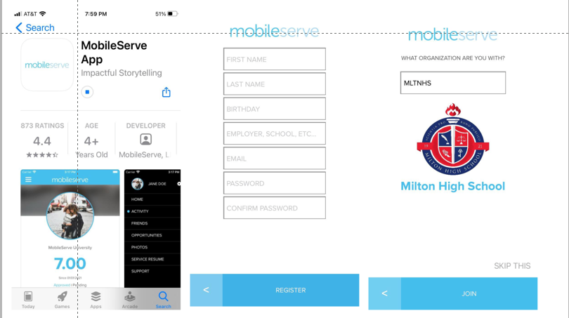
03
CREATING A MOBILESERVE ACCOUNT:
-Download MobileServe app
-Create an account using PERSONAL EMAIL
-Enter the code MLTNHS for organization

Slide 8
04
FOLLOW THE NHS INSTAGRAM:
@NHSMILTON
05
JOIN REMIND-DOWNLOAD THE APP!:
Juniors @446hkf
Seniors @72842hc
06
ATTEND THIS MEETING! :)
07
ATTEND THE INDUCTION CEREMONY THURSDAY 9/10, 7:30AM IN THE THEATRE (REPORT @ 7:15)
-Mandatory! Parents welcome but have to sign in at the front desk!

Slide 9
WEBSITE
https://miltontag.wixsite.com/miltonnhs
-Calendar with all important dates
-MobileServe and policy info under “members”
-Presentations under “members” -> “meetings”
-FOLLOW STEPS ON NEW MEMBER CHECKLIST UNDER “HOME” -> “ACCEPTANCE” TO BE INDUCTED!

Slide 10
SERVICE HOUR REQUIREMENTS
20 TOTAL
10 MIN. NHS
10
INDIVIDUAL
-You are required to earn 20 hours minimum this semester (20 flat- no rounding!)
-A minimum of 10 must be from NHS opportunities (5 max donation - $10=1hr)
-A maximum of 10 can be individual hours through a certified nonprofit.
-You also can earn MAX 5 rollover hours to count for individual hours next semester
HOURS WILL BE DUE 12/31/2025

Slide 11
MOBILESERVE
-You’ll sign up for opportunities and log hours in MobileServe
-Menu-> Opportunities-> Invitations -> Sign up!
-Log hours from the homepage
-Check if your hours have been approved through the “Activities” tab

Slide 12
V
MOBILESERVE LOGGING
LOG HOURS WITHIN 3 DAYS OF THE OPPORTUNITY
-ALL hours will go through MobileServe and will be approved/rejected by Hollis. Make sure to check on the status of your hours and resubmit if your hours get rejected initially!
-You must log hours within 3 days of volunteering. Any submissions after that time will not be approved. If you fail follow the logging procedures correctly, your hours will be rejected and Hollis will provide a reason why. You may fix your submission and resubmit to be approved.
2.
INCLUDE 3 PICTURES- ONE MUST BE A FACE PICTURE
3.
DROPPING OUT OF AN OPPORTUNITY LESS THAN 48 HOURS WITH NO REPLACEMENT INCURS 2 ADDITIONAL HOURS
4.
DROPPING OUT A SECOND TIME INCURS 6 ADDITIONAL HOURS

Slide 13
V
MOBILESERVE LOGGING STEPS
Click on the blue “LOG HOURS BUTTON at the bottom of the screen. Select the date you volunteered and enter the total hours you spent volunteering. (Ex- 3 hrs and 30 minutes =3.5)
2.
“Service Organization” Box= Through NHS (Service or Donation) or Individual. Check next slide for formatting!
3.
“Category”Box= Select “Service Hours”. For “Tell Your Story”, describe what you did while volunteering. Then click next.
4.
Submit 3 Photos under “Verification”. At least once picture must have your face in it. After completing all the above steps, press “Submit Hours” and check to make sure they get approved!

Slide 14
V
MOBILESERVE LOGGING
LOG HOURS WITHIN 3 DAYS OF THE OPPORTUNITY
Logs should be labeled as:
Milton- ___(opportunity name)___________
For NHS SERVICE opportunities
Milton Donation- ____(donation drive name)____
For NHS DONATION opportunities
Individual- _____(nonprofit name)______
For non-NHS hours
2.
INCLUDE 3 PICTURES- ONE MUST BE A FACE PICTURE
3.
DROPPING OUT OF AN OPPORTUNITY LESS THAN 48 HOURS WITH NO REPLACEMENT INCURS 2 ADDITIONAL HOURS
A+
DROPPING OUT A SECOND TIME INCURS 6 ADDITIONAL HOURS

Slide 15
MEETING
ATTENDANCE
IS REQUIRED!
-Email miltonnhs01@gmail.com if you have to miss for an excused reason BEFORE the meeting!
-You have to stay on the meeting for the entirety of it
-1 missed meeting gets a warning
-2+ missed meetings leads to attendance probation (1 additional hour needed for each meeting missed)

Slide 16
Board Member Elections
@ SEPTEMBER 9th meeting
BOARD MEMBERS…
-Attend monthly officer & full chapter meetings
-Find and attend 2-3 service initiatives per month
-Record attendance and monitor sign-ups/drop-outs

Slide 17
APPLYING
FOR
BOARD MEMBER:
-5 Board Members will be elected, 3 of which must be juniors
Being a board member is a GREAT step to becoming an officer next year!
-You will receive an email that outlines Board Member responsibilities and has an application.
-After you submit your form, you will give a 1-2 min speech at the 9/9 meeting on Teams and all members will vote!

Slide 18
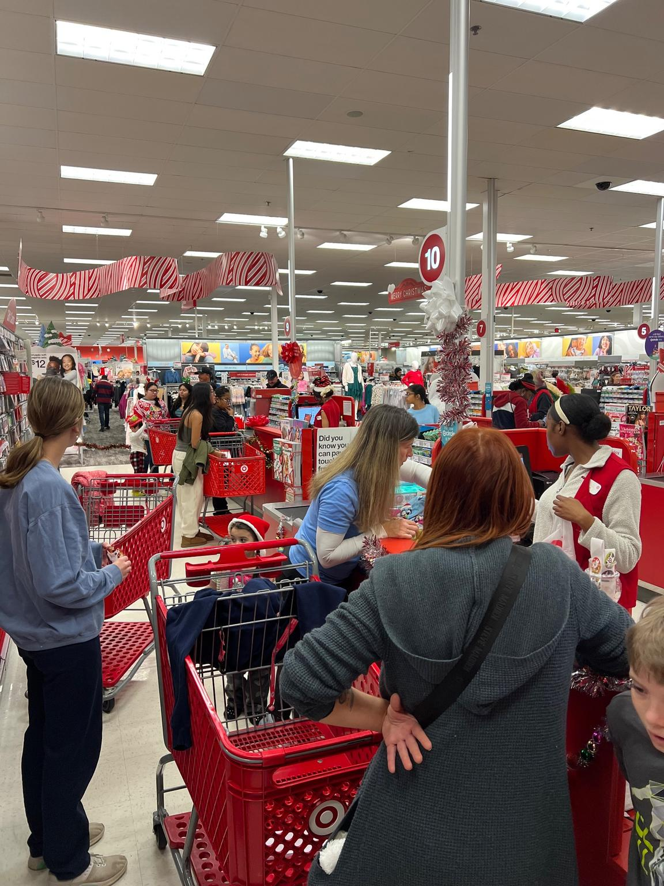
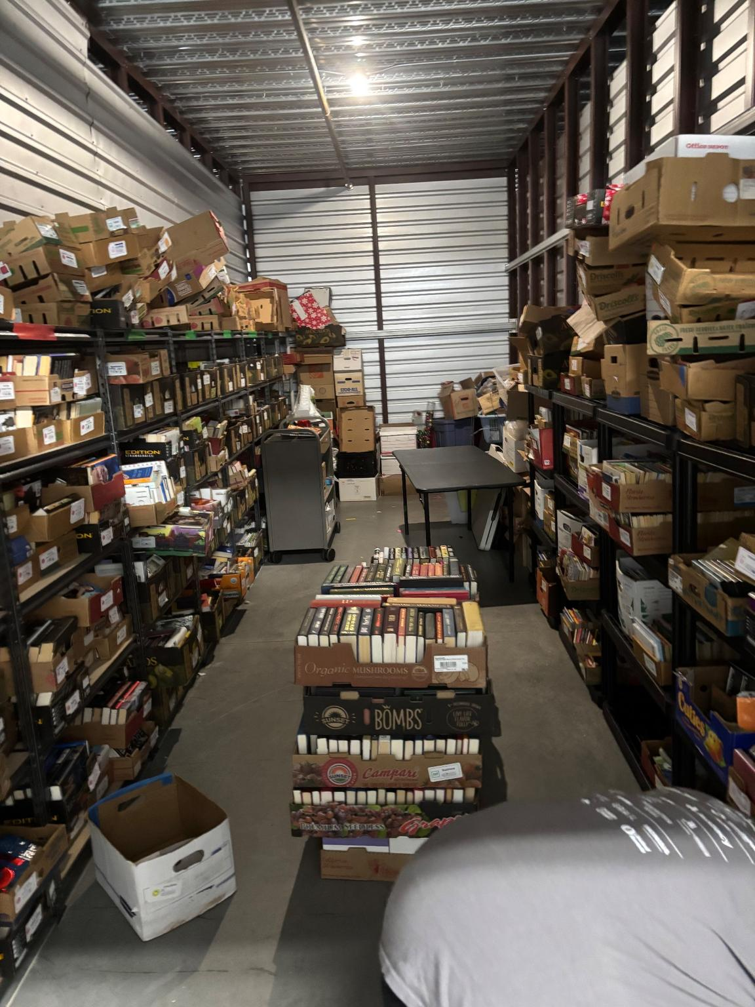
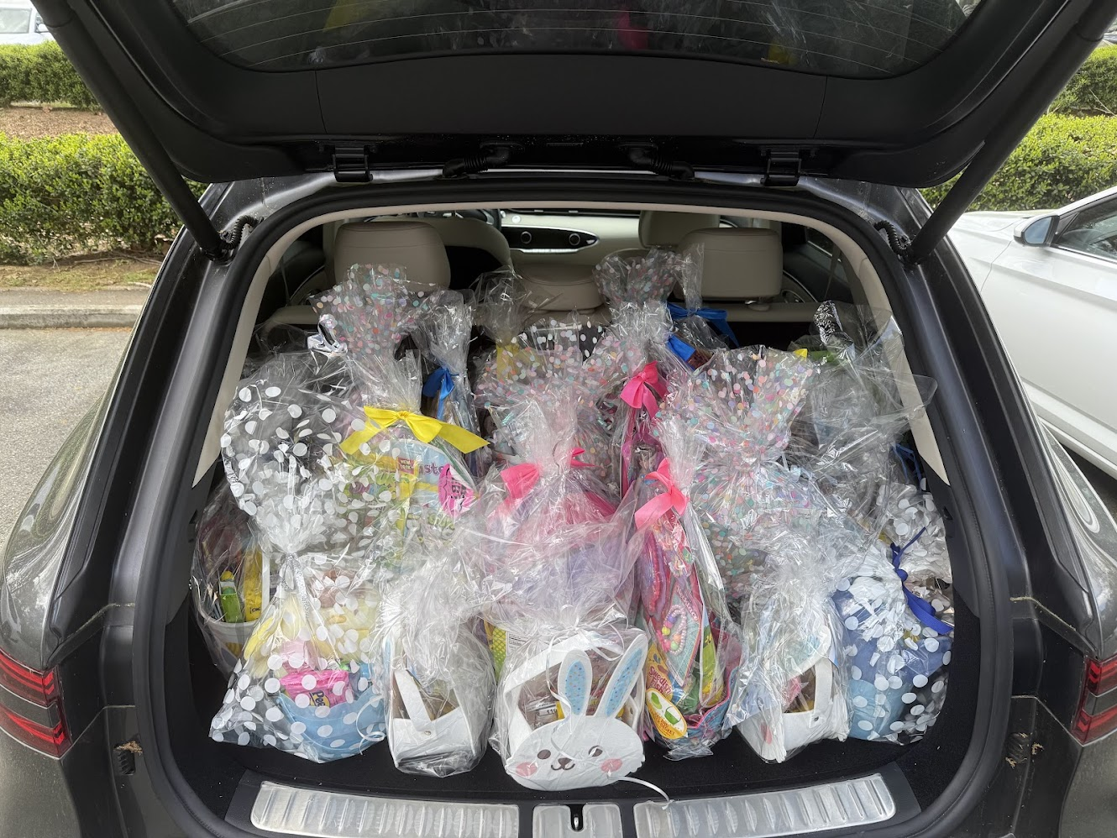
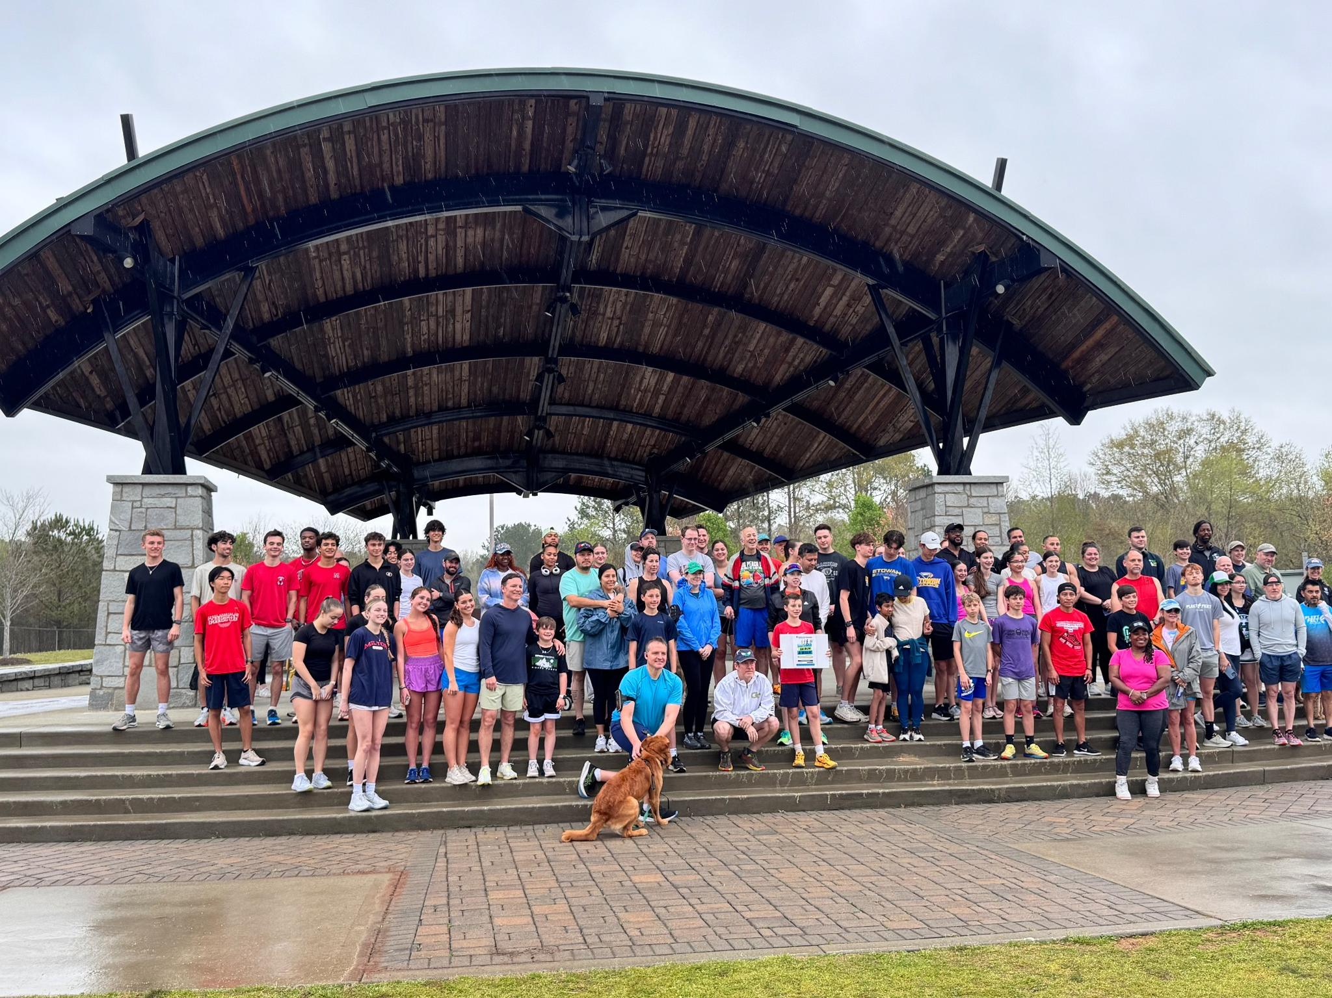
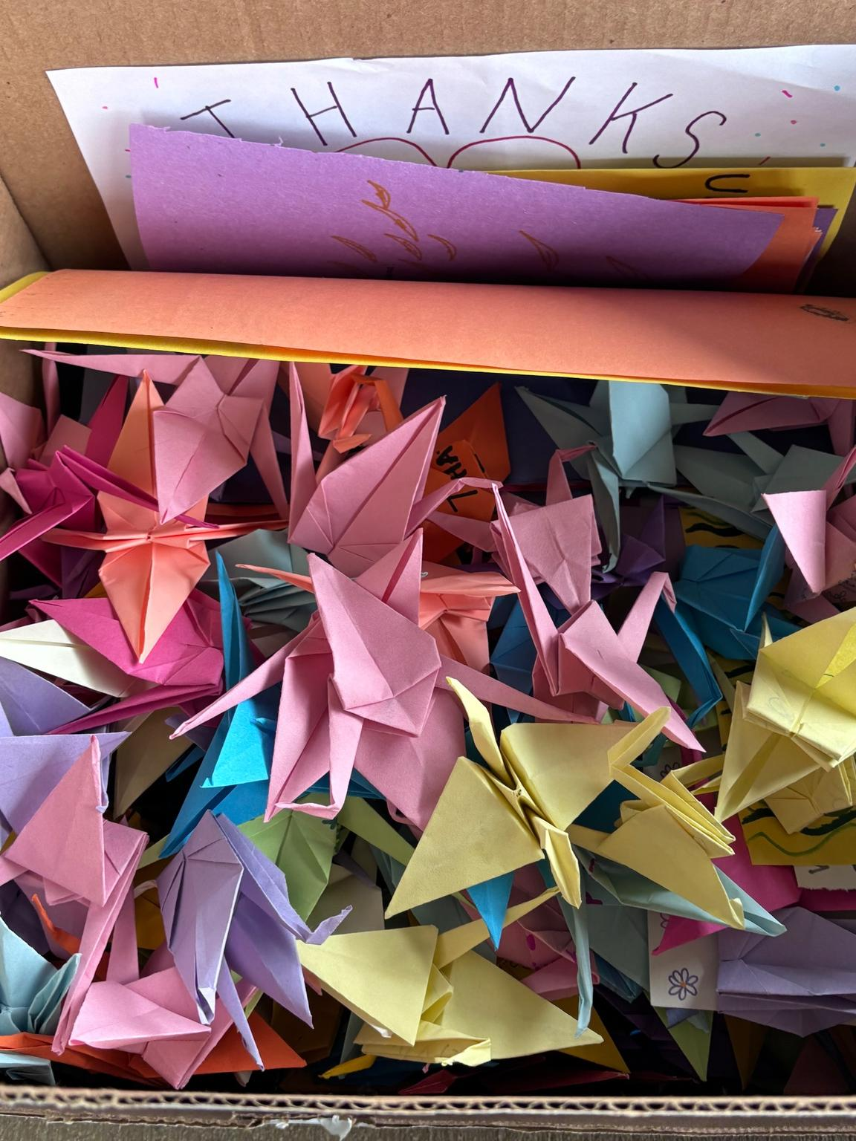
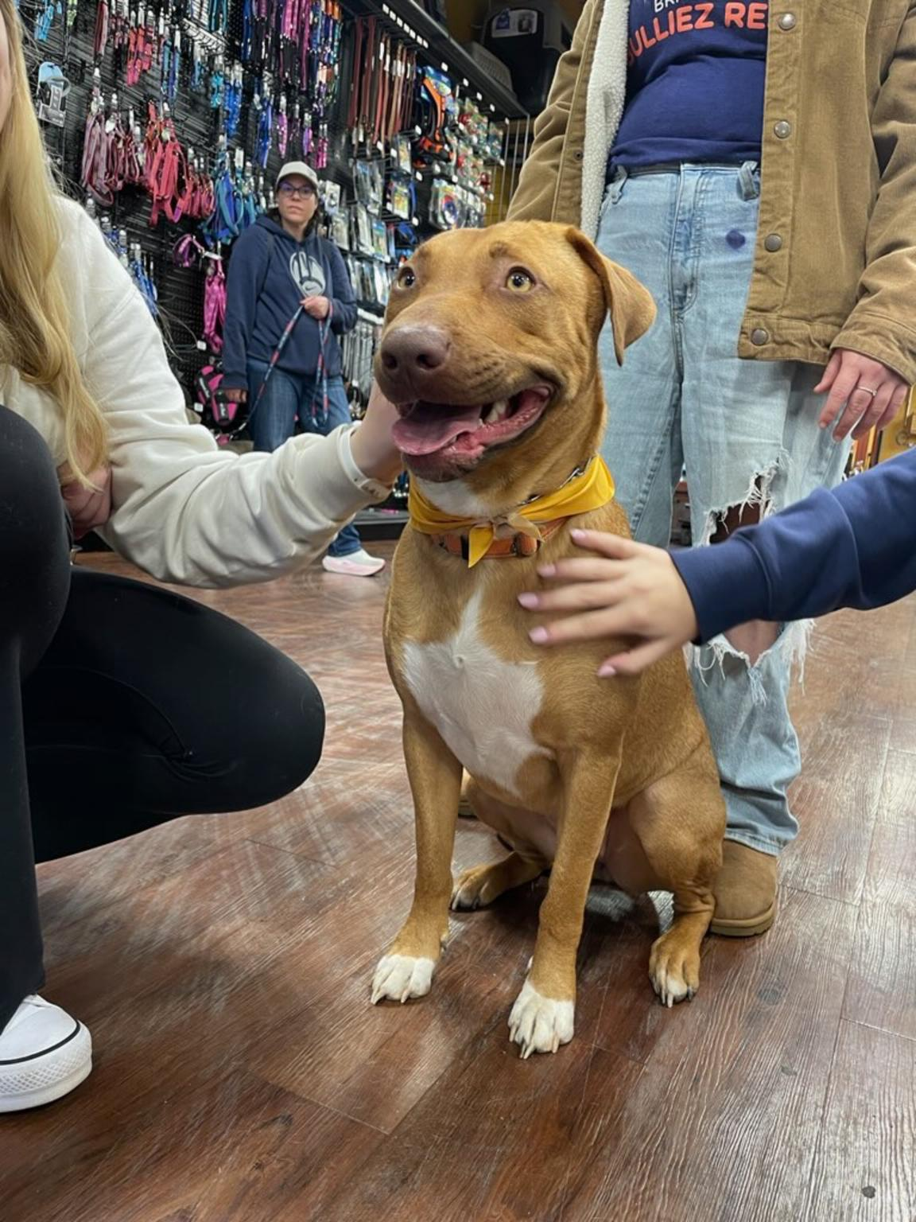
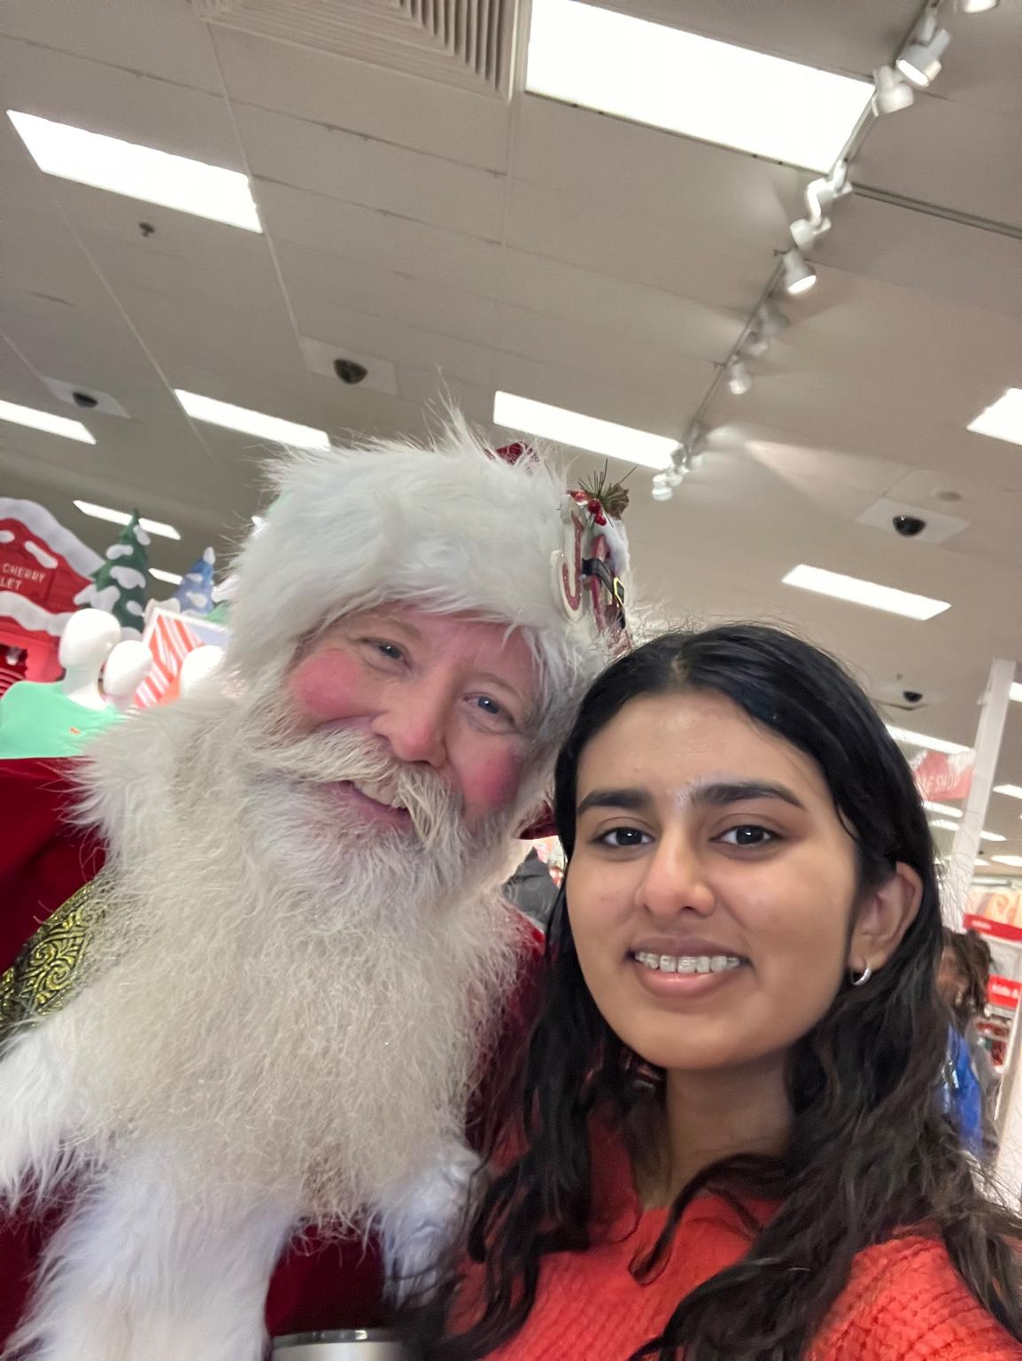
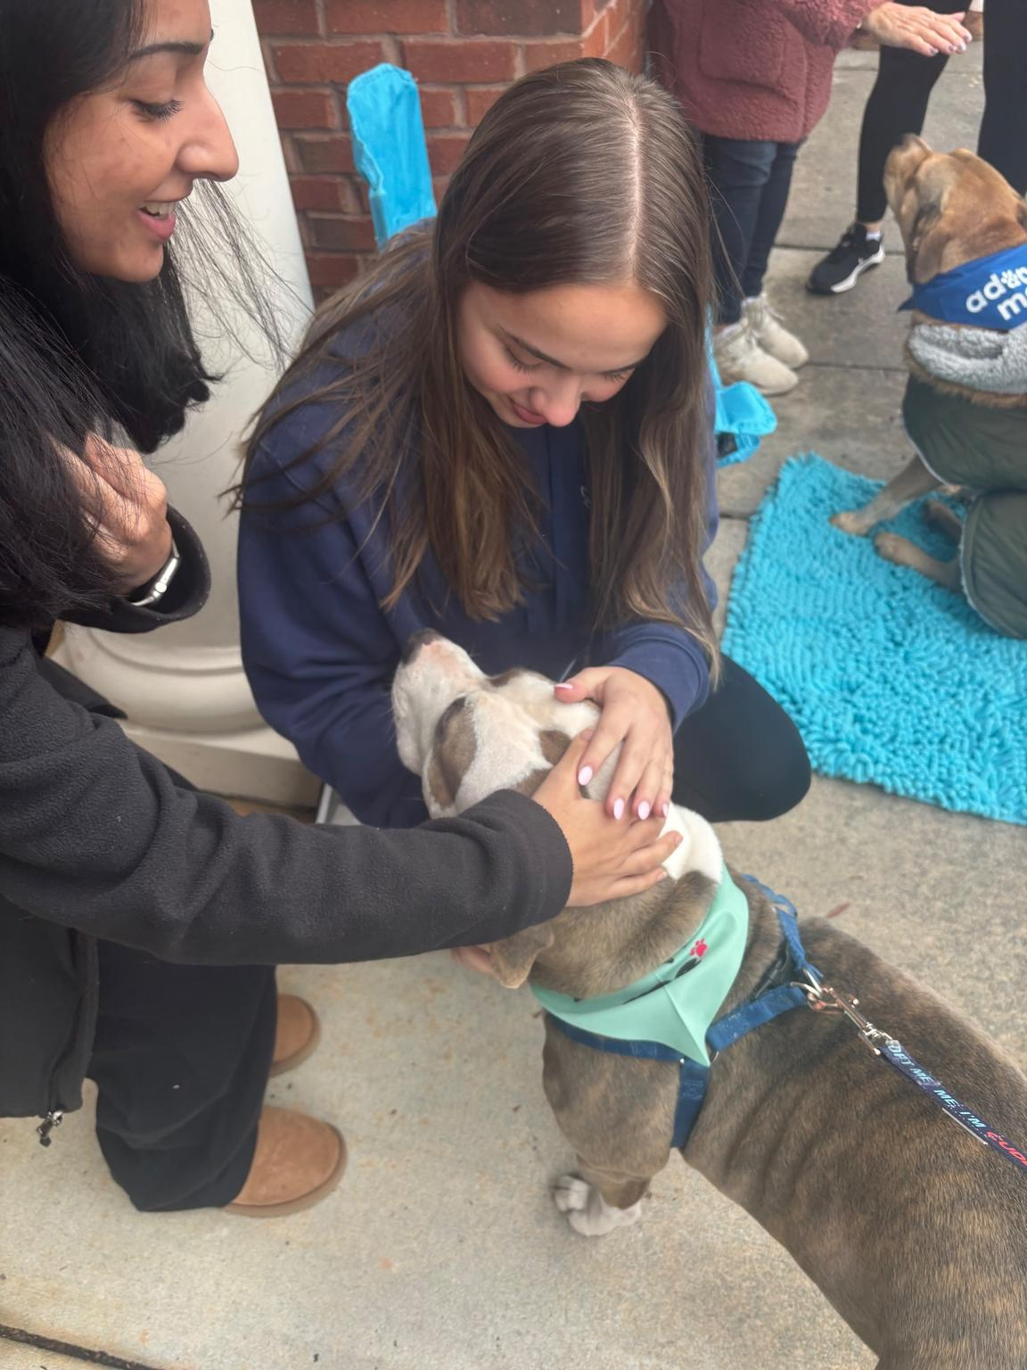
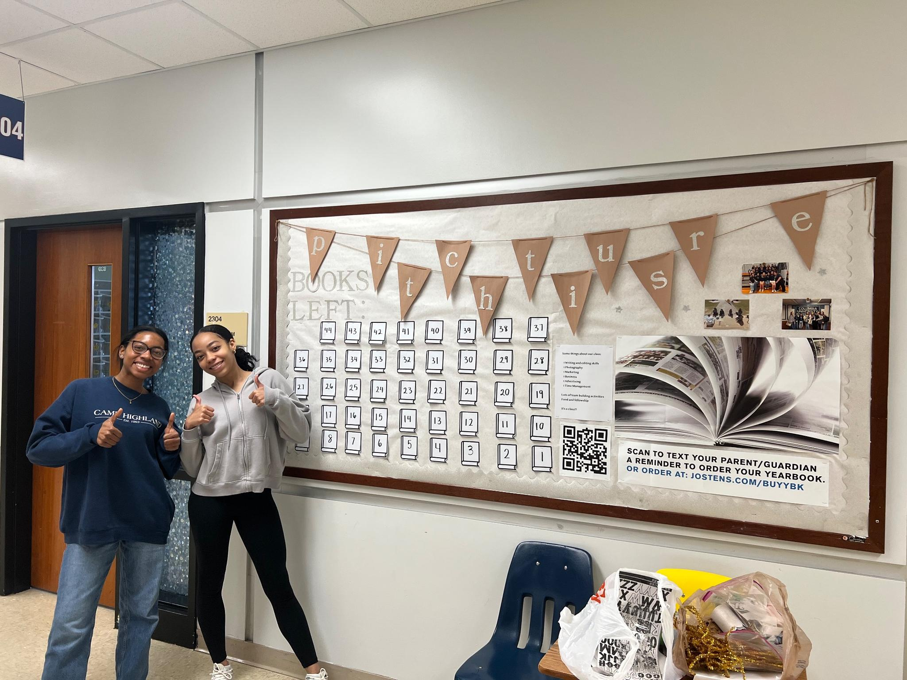
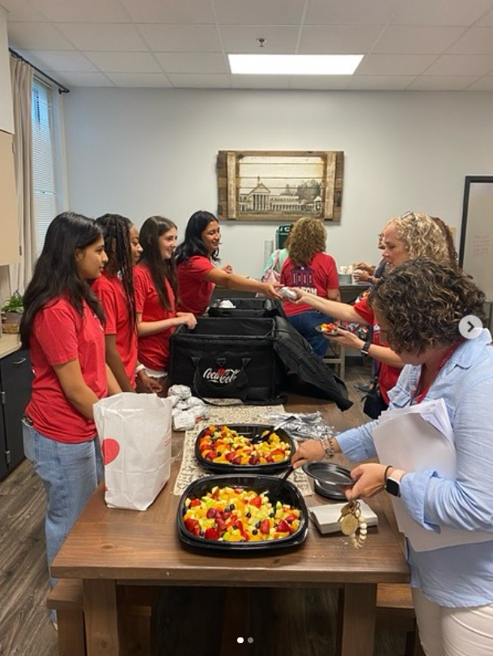
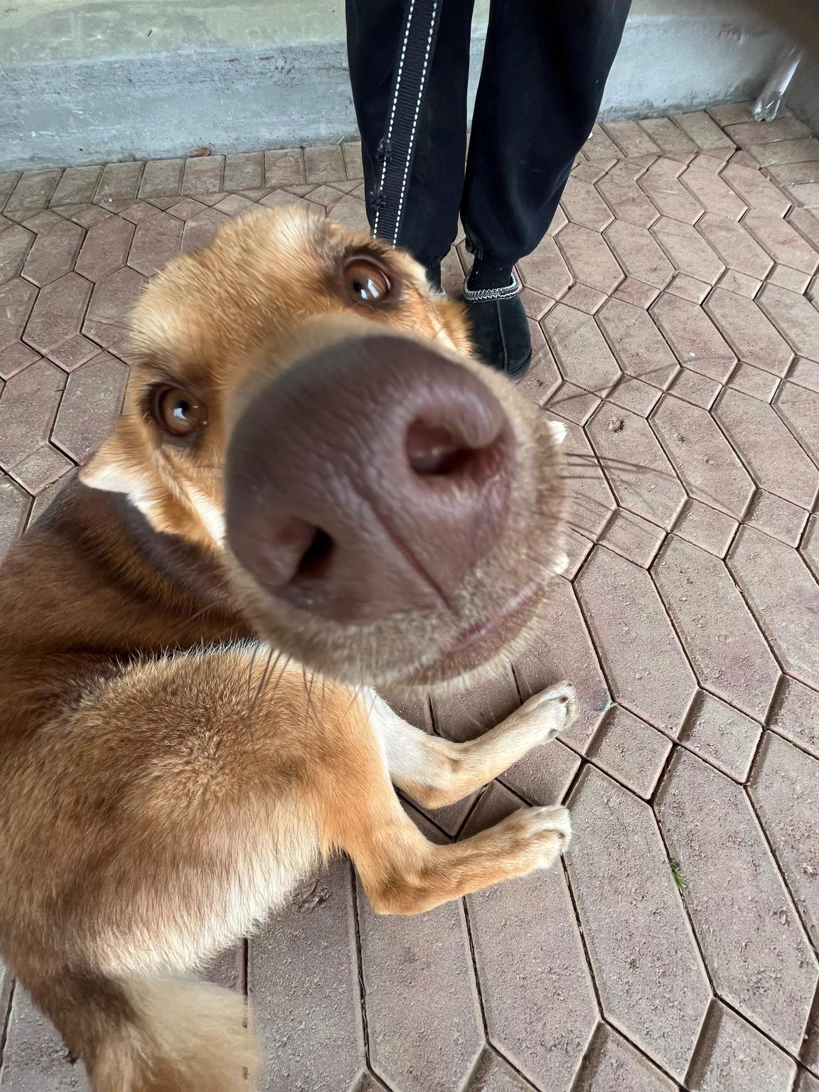
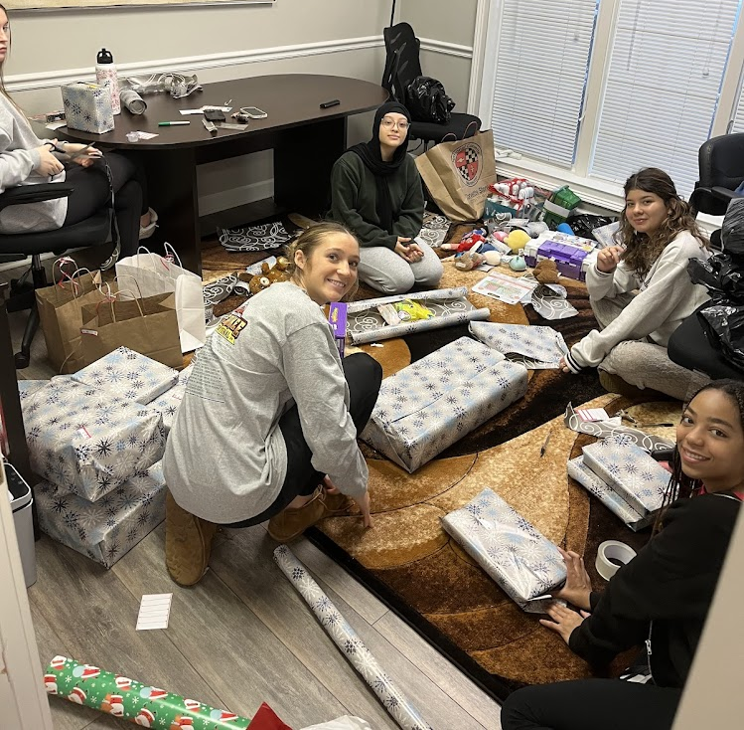
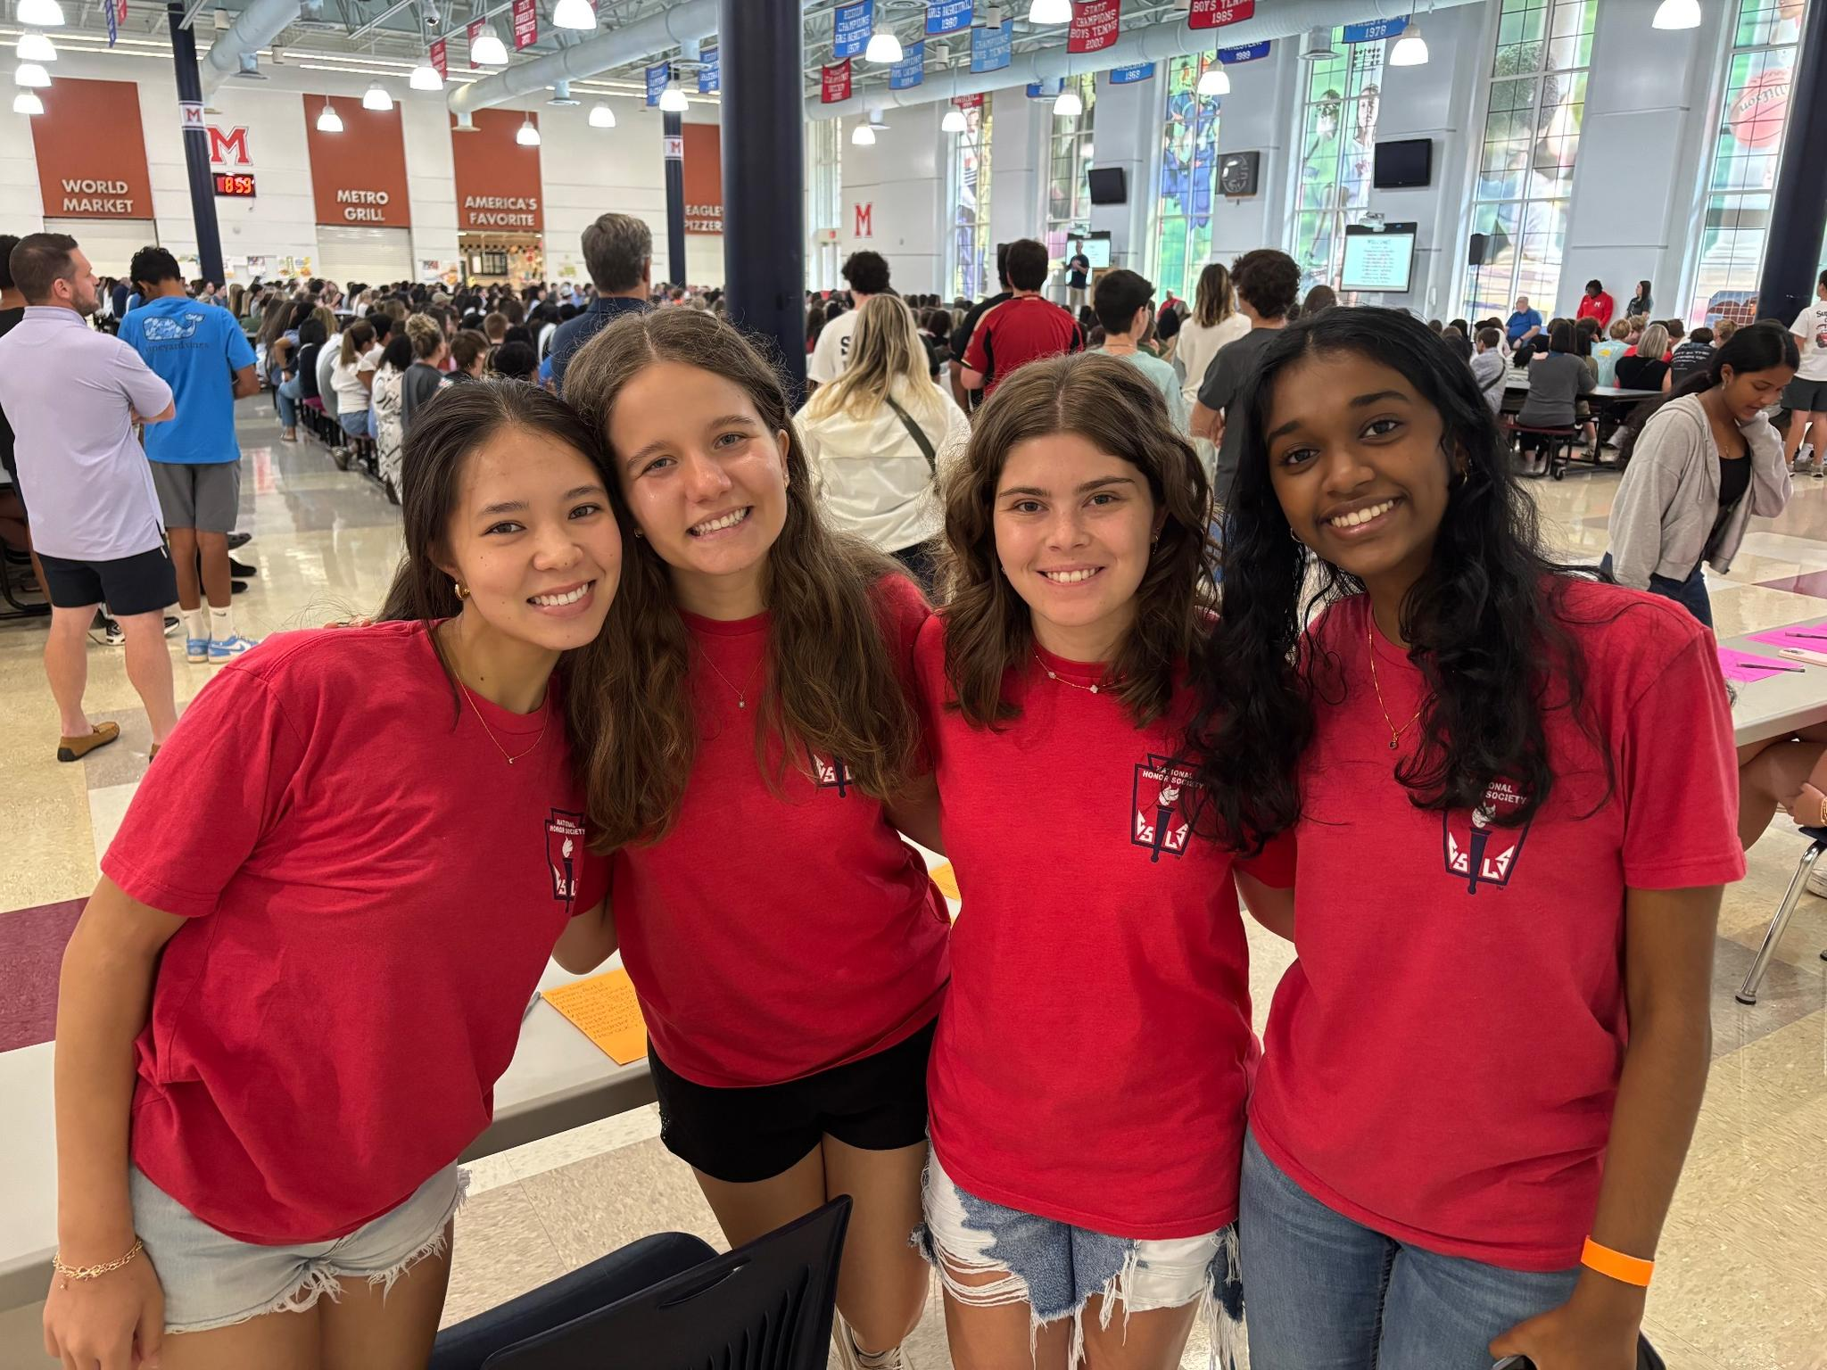
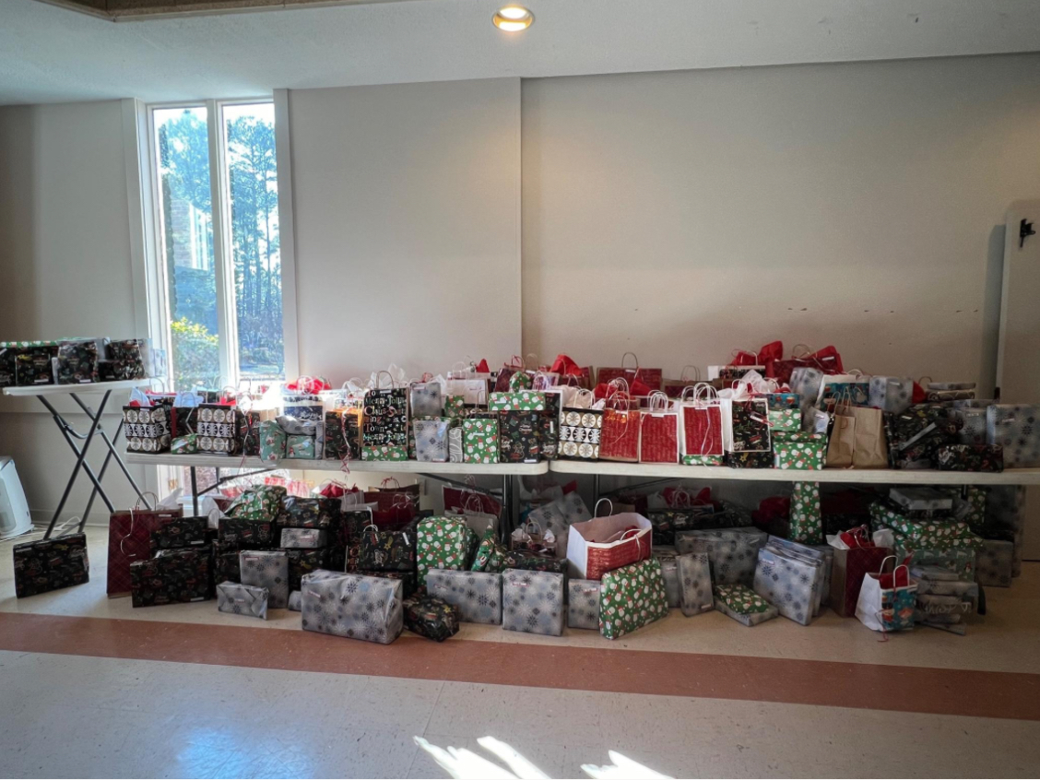
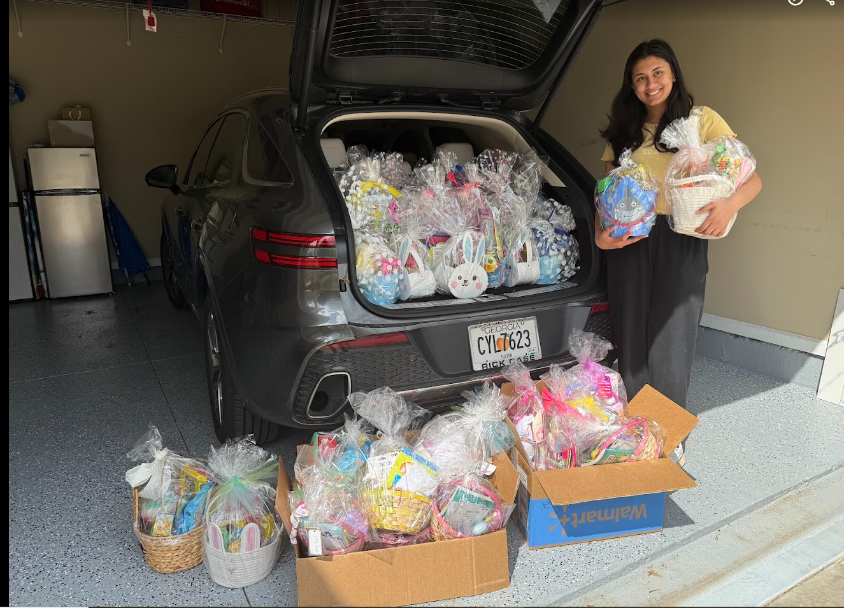
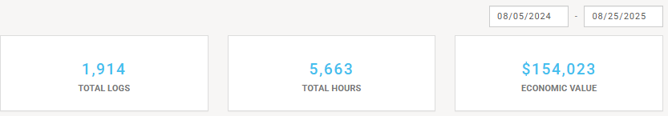
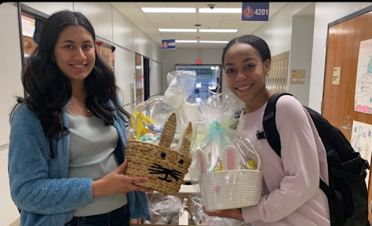

Slide 19
SERVICE OPPORTUNITIES

Slide 20

STEAM NIGHT

Slide 21

FASTPITCH CONCESSIONS

Slide 22


9/11 CEREMONY

Slide 23

BLESSINGS IN A BACKPACK

Slide 24

GIGI’S PLAYHOUSE

Slide 25

LIBRARY BOOK SALE

Slide 26
Thank You!
HAVE A GREAT DAY

